Slide 1
MOVIE DATABASE
Bartosz Dabkowski
Paul Kessler
Joscelyn Kim

Slide 2
What is our Database?
Movie Distribution with multiple distribution centers across country
Database keeps track of
Employees
Customers
Location of distribution centers
Departments
Inventory
Movies
Actors in movies
Movie Reviews
Customer Orders

Slide 3
What does it do?
Customers order movies from a large selection
Database keeps track of where customers live to find closest distribution center
Can track each users preferred genre
Can track how many movies each customer ordered
User can find all movies a certain actor has starred in
Users can track all movies in a certain genre

Slide 4
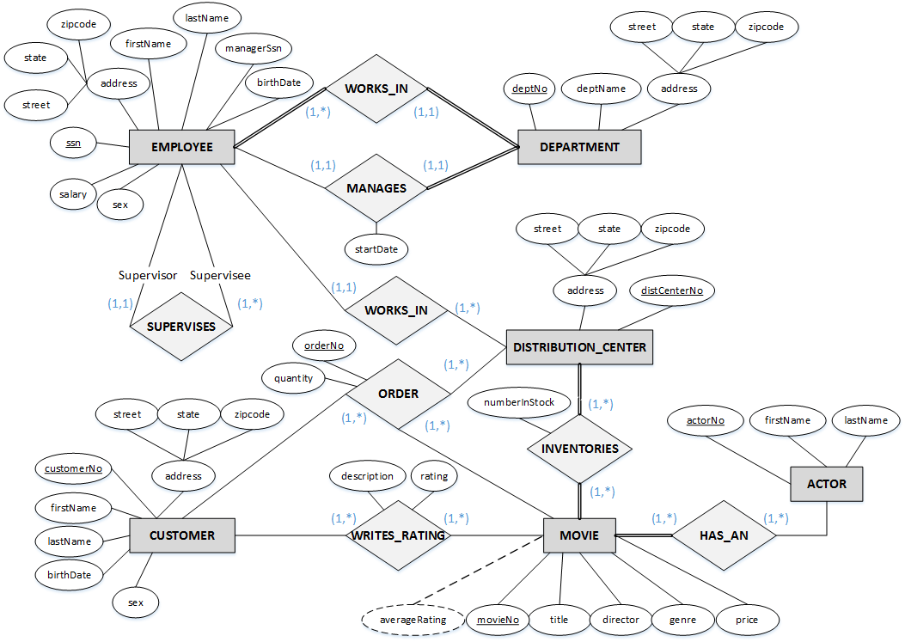
ER Diagram

Slide 5
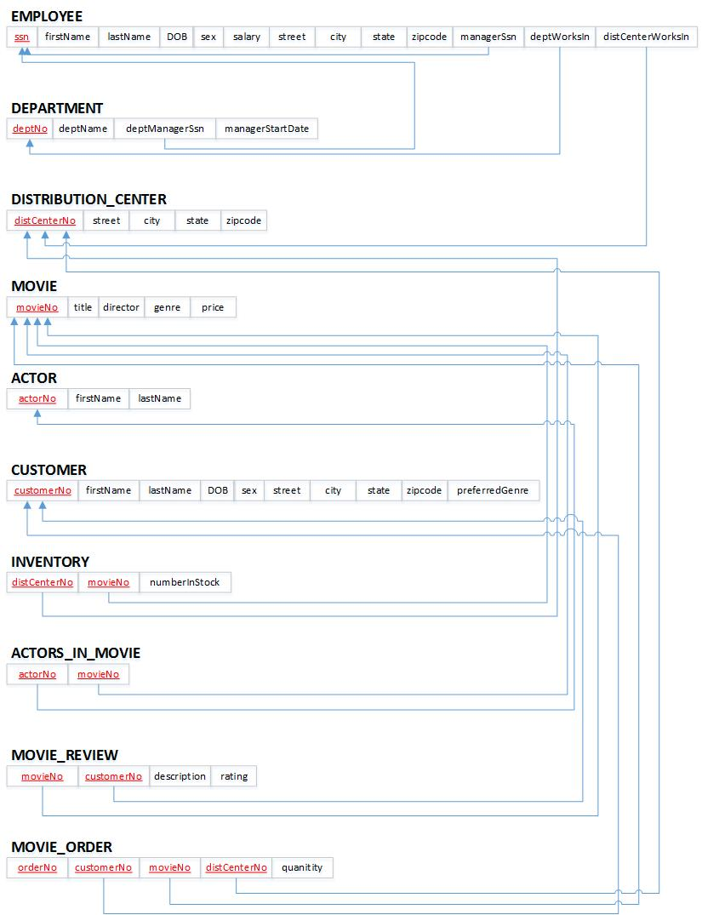
Rational Model

Slide 6
Queries
Search movies by genre
Search movies directed by specific director
Search all movies with 5-star rating
Search all movies with a certain actor/actress
Search movies within a price range
Search movie orders with specific movie title
Search employees in a distribution center
Search employees that live in a specific state
Search customers who prefer a genre

Slide 7
2NF

Slide 8





3NF

Slide 9


BCNF

Slide 10
Evaluation
Overall
What went well
What went bad
What would we do differently next time

Slide 11

The End

